Slide 1


Fire Bird V P89V51RD2
Servo Control using
PWM and Timer 0
By Pawankumar Suryawanshi

Slide 2
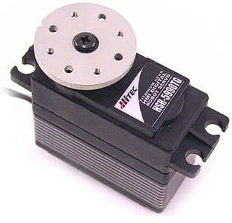
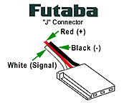
Servo Specification and Working
Servo uses a “J” type connector and has three leads to operate the servo.
Hobby RC servo motors turn to some angle, based on a PWM control signal.
The servo PWM signal consists of a 50Hz (20ms period) pulse train.
The pulses may vary from 1ms - 2ms in width for motion.
0.5-2.5ms pulse is needed for full range of motion.

Slide 3
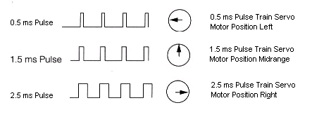
Servo Working
Pulse Width Duty / ms | Angle / degrees
0.5 | 0
1.0 | 45
1.5 | 90 (center)
2.0 | 135
2.5 | 180

Slide 4
Calculate M/C and its Time
Crystal Frequency is 11059200
For one M/C it required 12 clock cycles
Then, 11059200/12=921600 M/C per Sec
So, For 1 M/C time required is
1000000(uSec) / 921600=1.08506944 uSec
1 Machine Cycle = 1.0850 uSec

Slide 5
Programmable Counter Array
We use PCA to generate PWM for motion control which is 8bit PWM.
Counter of PWM increment after each machine cycle and over flow the counter at 0xFF.
It means it generate pulse of 256 cycle
i.e. 256 x 1.0850 uSec = 277uSec
But Servo requires 20mSec Pulse.
So we can not use normal PWM mode.
For that, use Time0 for PWM generation.

Slide 6
Timer 0
Timer 0 is work in 8bit or in 16bit mode.
We will use it in 8 bit mode.
Timer0 is use to generate Servo PWM pulse of 50Hz (20msec) .
Timer0 increment after each M/C, and when it overflow that time it will increment PCA counter by 1.
No. of Machine cycles in 20msec.
=20(msec)/1.085(usec)
=20000/1.085
=18433
Range for Timer0 in 8 bit is Form 0x00 to 0xFF
So, 18433 / 256 = 72

Slide 7
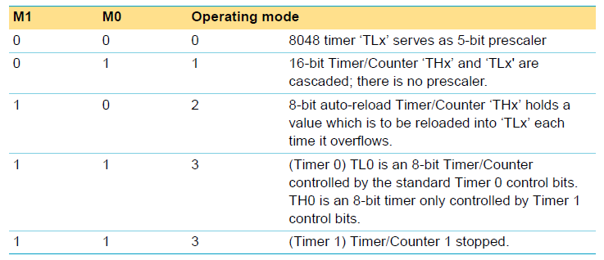
TMOD - Timer/Counter mode control register
TMOD=0x02; //Set Timer0 for 8bit overflow mode

Slide 8
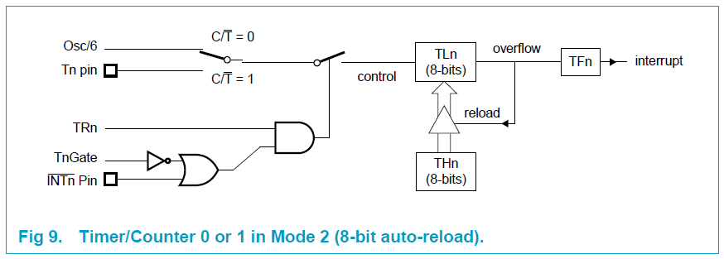
TMOD - Timer/Counter mode control register
Timer should reload after 72 cycles means
256-72= 184 i.e 0xB8
TH0=0xB8;

Slide 9
TCON to on Timer0
TR0=1; //To on Timer0

Slide 10
Initialize PCA to work with Timer0
CMOD : PCA Counter Register Mode
CMOD=0x04; //Counter increment after Timer0 overflow
Bit | Symbol | Description | Bit Value
7 | CIDL | Counter Idle Control : CIDL=1, PCA counter gated off during idle. | 0
6 | WDTE | Watchdog Timer Enable: WDTE = 0; disable Watchdog timer | 0
5 | - | Reserved for future use. Should be set to 0 | 0
4 |  |  | 0
3 |  |  | 0
2 | CPS1 | PCA Count Pulse Select: CSP1 = 1; CSP0 = 0; Timer 0 Over Flow | 1
1 | CPS0 |  | 0
0 | ECF | PCA Enable Counter Overflow Interrupt. ECF = 0 disables that function. | 0

Slide 11
CCON – PCA Counter Control Register
Used to start PCA Counter.
Bit | Symbol | Description | Bit Value
7 | CF | PCA Counter Overflow Flag | 0
6 | CR | PCA Counter Run Control Bit : CR=1, Turn On PCA Counter | 1
5 | - | Reserved for future use. Should be set to 0 | 0
4 | CCF4 | PCA Module 4 Interrupt Flag, (Not Use). | 0
3 | CCF3 | PCA Module 3 Interrupt Flag, (Not Use). | 0
2 | CCF2 | PCA Module 2 Interrupt Flag, (Not Use). | 0
1 | CCF1 | PCA Module 1 Interrupt Flag, (Not Use). | 0
0 | CCF0 | PCA Module 0 Interrupt Flag, (Not Use). | 0
CCON=0X40;

Slide 12
CCAPMn – PCA module Compare/Capture Register
Used to enable PWM generator.
Bit | Symbol | Description | Bit Value
7 | - | Reserved for future use. Should be set to 0 | 0
6 | ECOMn | Enable Comparator : ECOMn = 1 enables the comparator function. | 1
5 | CAPPn | Capture Positive : CAPPn = 0; Disable positive edge capture. | 0
4 | CAPNn | Capture Negative : CAPNn = 0; Disable negative edge capture. | 0
3 | MATn | Match : MATn = 0; Disable flagging of the interrupt in CCFn bit in CCON register. | 0
2 | TOGn | Toggel, TOGn = 0; Disable toggeling of the CEXn when match of the PCA counter with this module’s compare/capture register occours. | 0
1 | PWMn | Pulse Width Modulation Mode. PWMn = 1; Enables the CEXn pin to be used as a pulse width modulated output. | 1
0 | ECCFn | Enable CCF Interrupt, ECCFn = 0; Disables compare/capture flag CCFn in the CCON register to disable generation of an interrupt. | 0
CCAPMn=0X42; // n is Channel Number

Slide 13
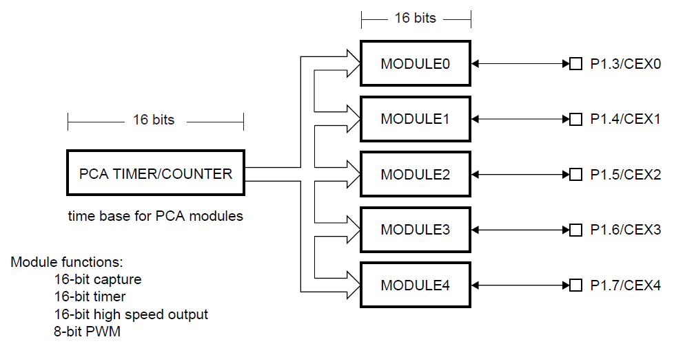
Programmable Counter Array

Slide 14
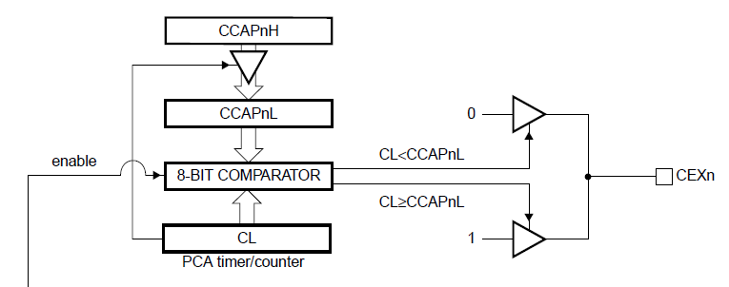
CCAPnH and CCAPnL
CCAPnH and CCAPnL registers are use to set duty cycle which are associated with each of PCA module.
Initialize CCAPnH to reload CCAPnL
CCAPnH=0x00;

Slide 15

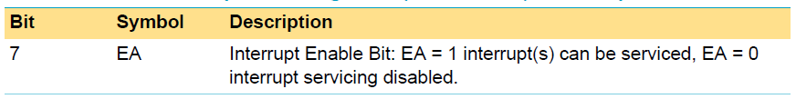
IEN0 - Interrupt enable register
We required to disable and enable the interrupt service routine for a moment.
  IEN0=0x00; /* Stop interrupt(s) */
  delay_ms(30);
  IEN0=0x80;/* Start interrupt(s) */

Slide 16
servo_init()
void servo_init()
{ /* Initial Timer0 Generate Overflow PCA */
TMOD = 0x02; // 8-bit auto-reload Timer/Counter ‘THx’ holds a value which is to be reloaded into ‘TLx’ each time it overflows.
TH0 = 0xB8;
TR0=1; // To on/set Timer 0
CMOD=0x04; //Clock get from Timer 0, Timer0 overflow = 1 clock to PCA
CCAPM0=0x42;
CCAPM1=0x42;
CCAPM2=0x42;
CCAPM3=0x42;
CCAPM4=0x42;
CCAP0H=0x00;
CCAP1H=0x00;
CCAP2H=0x00;
CCAP3H=0x00;
CCAP4H=0x00;
CCON=0x40;
IEN0 = 0x00; /*Stop interrupt */
P1 = 0xFF; /* Motor STOP */
delay_ms(30);
IEN0 = 0x80; /* Start interrupt */
}

Slide 17
Generated PWM of 20mSec (50Hz)
Consider it as 20mSec Time Period
For 0.5 mSec is = .5(mSec)*256/20(mSec) = 6.4
For 1.0 mSec is = 1.0(mSec)*256/20(mSec) = 12.8
For 1.5 mSec is = 1.5(mSec)*256/20(mSec) = 19.2
For 2.0 mSec is = 2.0(mSec)*256/20(mSec) = 25.6
For 2.5 mSec is = 2.5(mSec)*256/20(mSec) = 32
0
255
6
32

Slide 18
CCAPnH and CCAPnL
CCAPnH is assign after overflow in CCAPnL registers .
CCAPnH=(256-value)
Ex.: CCAP2H=(256-19.2);// For rotation of 90 degree

Slide 19
Positions available in 8bit PWM
Consider it as 20mSec Time Period
But here range for motion is limited,
Form value 7 to 31, ie. 7, 8, ….. upto 31
Total 25 Positions
0
255
6
32

Slide 20
Angle with respect to assigning value
0 to 180 degree means value from 7 to 31.
180 degree / 25 positions = 7.2 for one value.
value=((angle/7.2)+(6.4));
// 25 Positions || 6.4 is value for .5 mSec
// 180 / 25 position = 7.2 Multiply factor

Slide 21
run_servo(servo_no, angle)
void run_servo(unsigned char servo_no, unsigned int angle)
{
float value;
value=((angle/7.2)+(6.4)); // 25 Positions || 6.4 is value for .5 mSec
// 180 / 25 position = 7.2 Multiply factor
switch(servo_no)
{
case 1: CCAP2H=(256-value);
break;
case 2: CCAP3H=(256-value);
break;
case 3: CCAP4H=(256-value);
break;
}
}

Slide 22
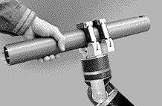
Thank You

